Slide 1
Ceis 190 Fundamentals of Information Technology & Networking I
By: Nicholas Cichon

Slide 2
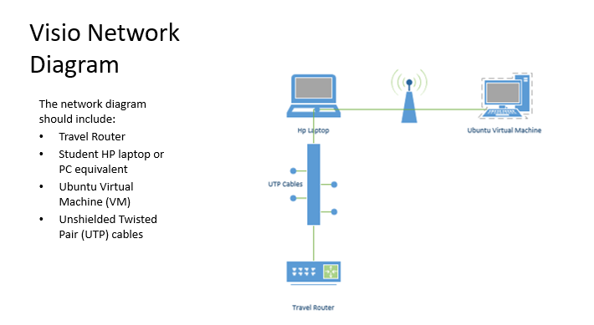
Module 1: visio network diagram

Slide 3
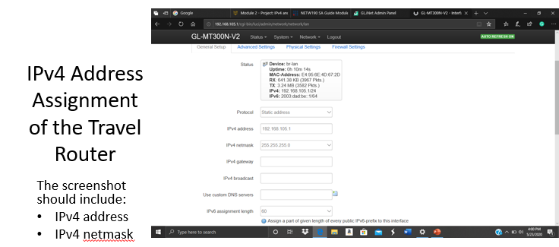
Module 2: ipv4 and ipv6 addressing

Slide 4
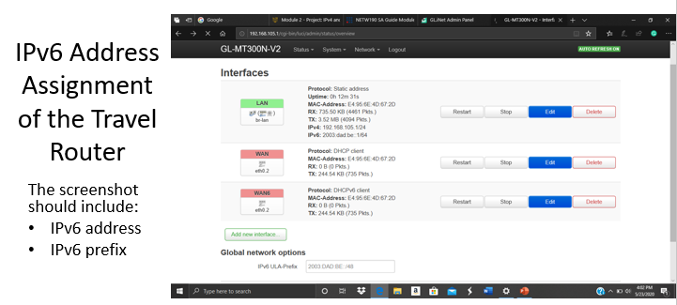
Module 2: ipv4 and ipv6 addressing

Slide 5
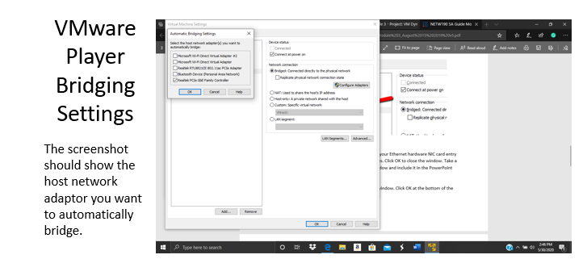
Module 3: Virtual Machine (VM) Dynamic IP Assignment

Slide 6
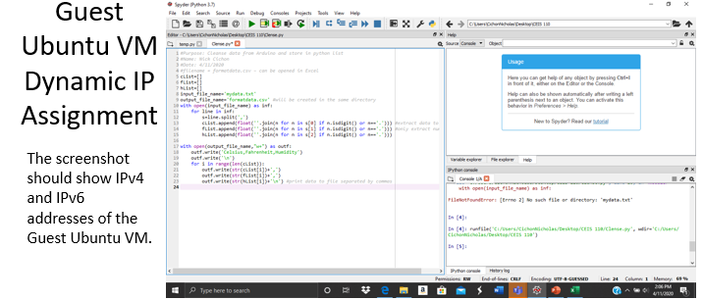
Module 3: Virtual Machine (VM) Dynamic IP Assignment

Slide 7
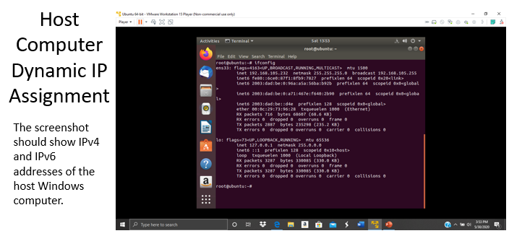
Module 3: Virtual Machine (VM) Dynamic IP Assignment

Slide 8
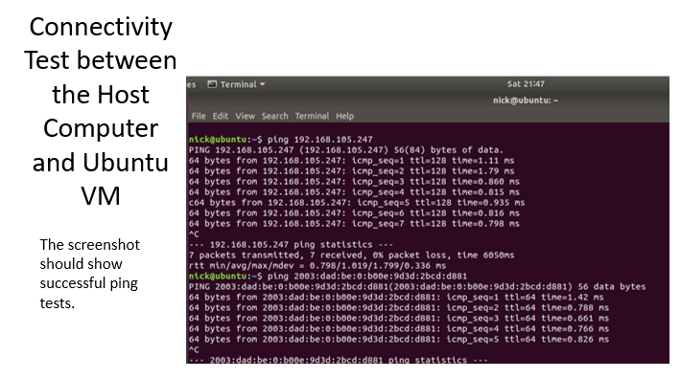
Module 4: connectivity test - ping

Slide 9
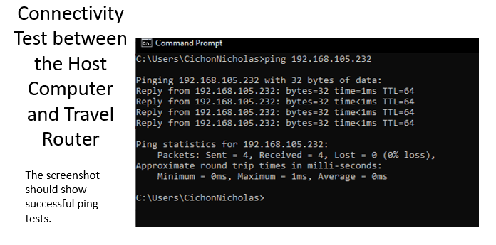
Module 4: connectivity test - ping

Slide 10
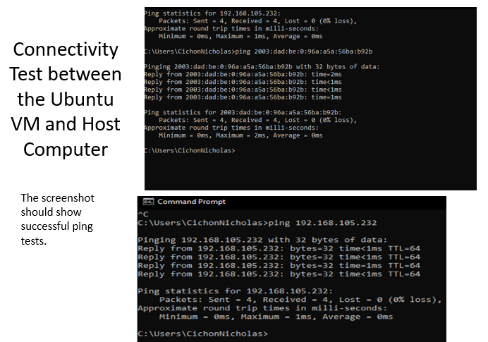
Module 4: connectivity test - ping

Slide 11
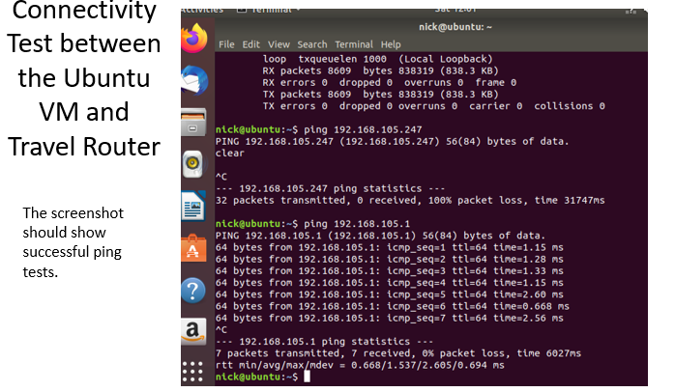
Module 4: connectivity test - ping

Slide 12
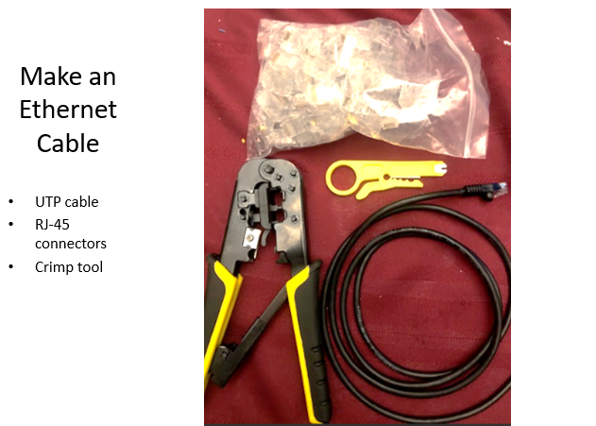
Module 5: make and test ethernet cable

Slide 13
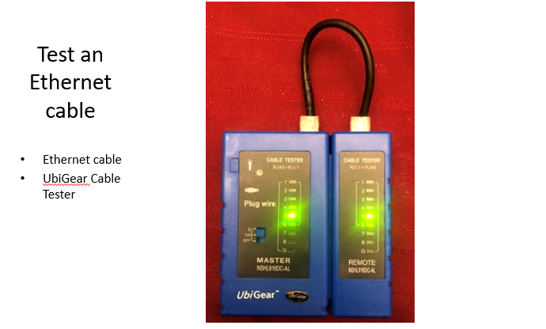
Module 5: make and test ethernet cable

Slide 14
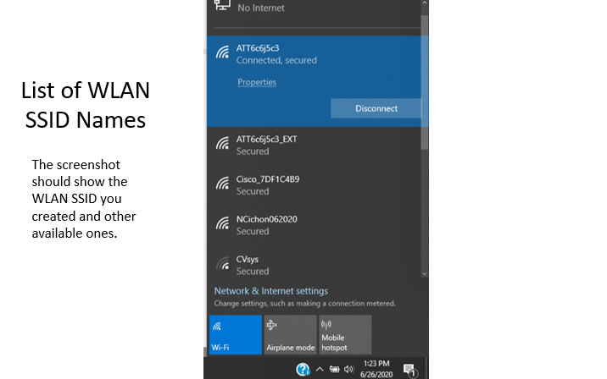
Module 6: wlan implementation

Slide 15
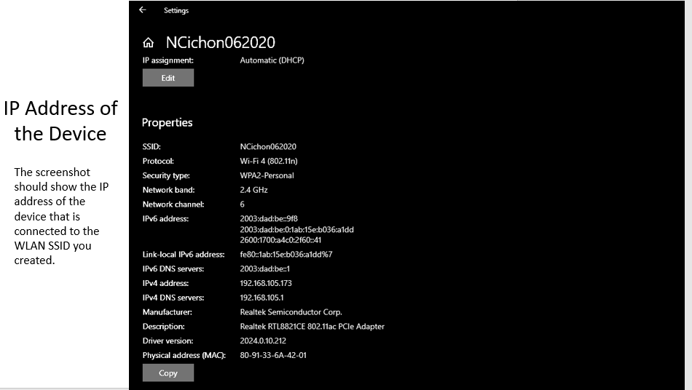
Module 6: wlan implementation

