Slide 1
Nicholas Cichon
SEC 290 Final COURSE PROJECT

Slide 2
Module 2: Intrusion Analysis using Wireshark

Slide 3
Module 2: Intrusion Analysis using Wireshark

Slide 4
Module 2: Intrusion Analysis using Wireshark

Slide 5
Module 3: Open SSL

Slide 6
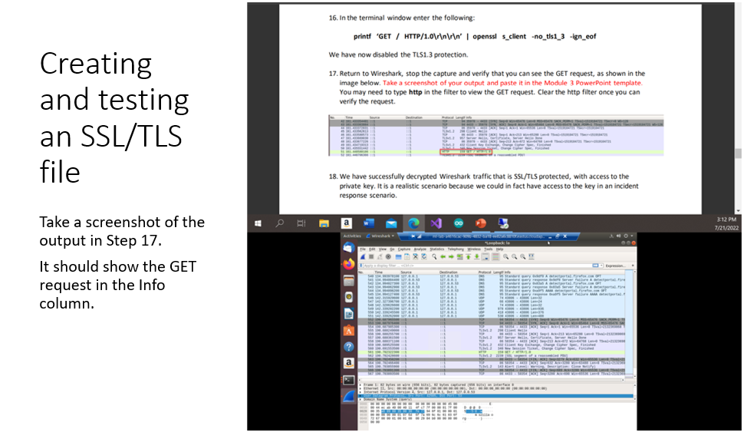
Module 3: Open SSL

Slide 7
Module 3: Open SSL

Slide 8
Module 3: Open SSL

Slide 9
Module 4: Snort

Slide 10
Module 4: Snort

Slide 11
Module 4: Snort

Slide 12
Module 4: Snort

Slide 13
Module 4: Snort

Slide 14
Module 5: Live Memory Analysis

Slide 15
Module 5: Live Memory Analysis

Slide 16
Module 5: Live Memory Analysis

Slide 17
Module 5: Live Memory Analysis

Slide 18
Module 5: Live Memory Analysis

Slide 19
Module 6: Firewall

Slide 20
Module 6: Firewall

Slide 21
Module 6: Firewall

Slide 22
Module 6: Firewall

Slide 23
Module 6: Firewall

Slide 24
Nicholas Cichon
Module 6: Firewall
Thank you

