Slide 1
Introduction to Operating Systems course
By: Nick Cichon

Slide 2
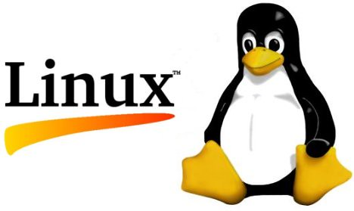
Introduction
Linux is an operating system (OS) used to run a variety of applications on a variety of different hardware components. It is a multiuser and multitasking OS that gives the ability to manage thousands of tasks at the same time and allows multiple users to access the system simultaneously.
Throughout this presentation I will display my knowledge on the Linux Operating System.

Slide 3
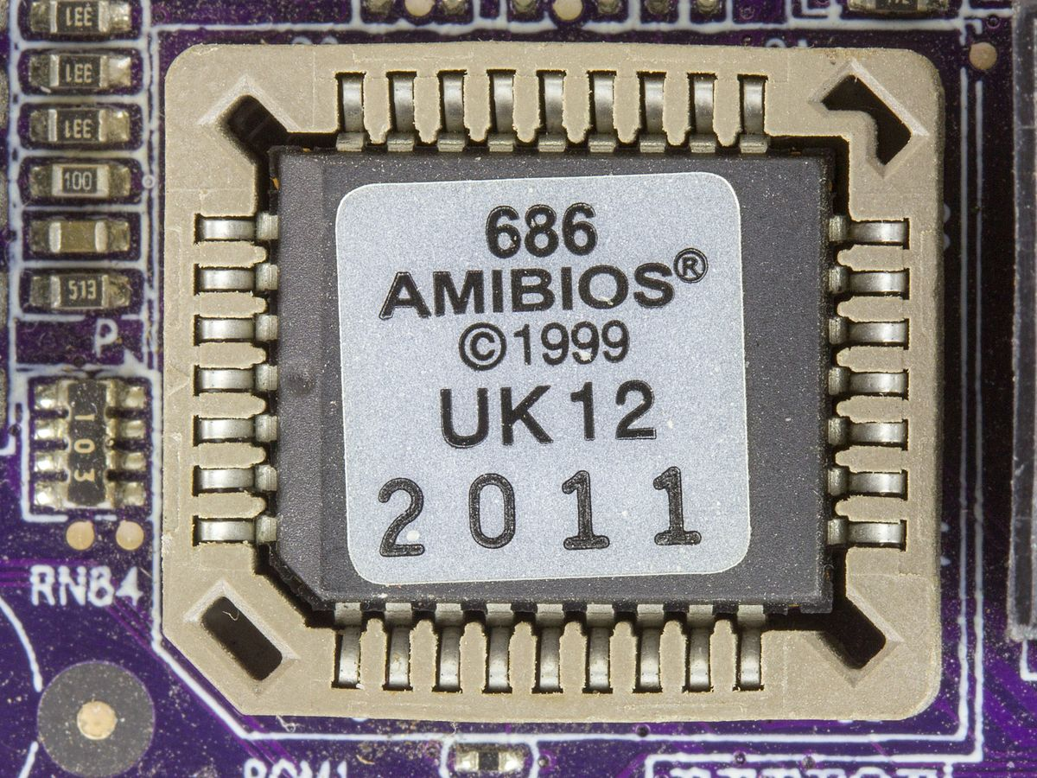
Enabling Virtualization on windows
How do you access your Base Information Operating System or BIOS?
Research how to access the BIOS on your computer
What keys/combination do you need to access the BIOS on your computer?
Answer here:
F10 for BIOS setup> System Configuration> Virtualization Technology <Enabled>
Do you have virtualization enabled on your laptop?
Answer here:
Yes

Slide 4
Flow chart for running Arduino on Virtual Machine
Flowchart with the following steps
Install Virtual machine
Install Linux on the VM
Install Arduino on the Linux image
Install the RTOS library for Arduino
Set up the Arduino hardware
Run the Arduino from the VM

Slide 5
Installing Linux ubuntu on VM

Slide 7
Installing Arduino ide

Slide 9
Script for rtos

Slide 12
Running Arduino from the virtual machine

Slide 15
Conclusion/closing statements
This class helped me experience an operating system that I originally was not familiar with which was Linux. Like many I have only really gained my IT knowledge from how Windows and Mac systems operate. However, This course showed me how Linux and other open operating systems like it are going to be the future of IT because of their overall customizability. Likewise, on a Linux operating system users are granted an infinite amount of control over the system versus Windows and Mac you are limited to what Microsoft or Apple allows you to control.

