Slide 1

Ceis110 programing in the iot
Nick Cichon

Slide 2
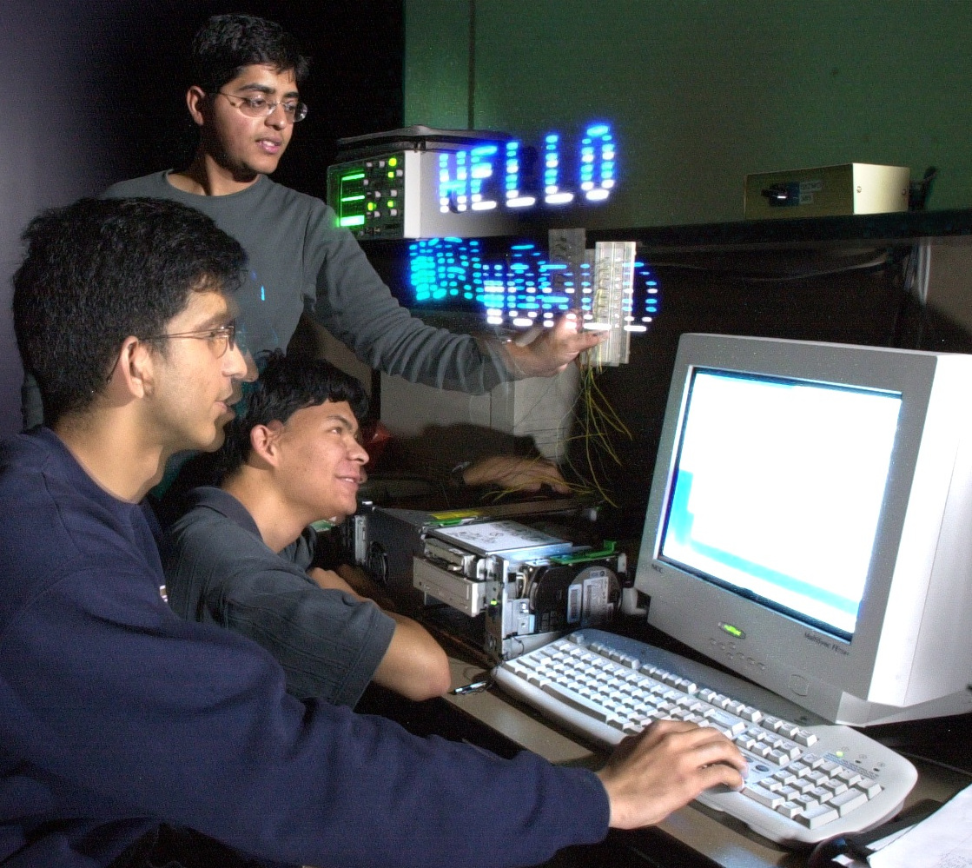
Introduction
Programing consists of instructions for the computer to follow to complete a set task or tasks. Throughout this class I learned about the Python programing language and how to use Anaconda and Spyder to run programs such as formatting a file for my temperature sensor data.
This Photo by Unknown Author is licensed under CC BY-SA

Slide 3
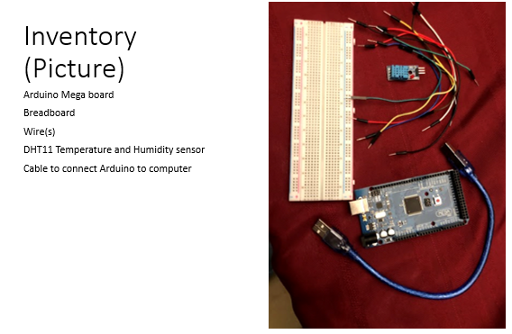

Slide 4
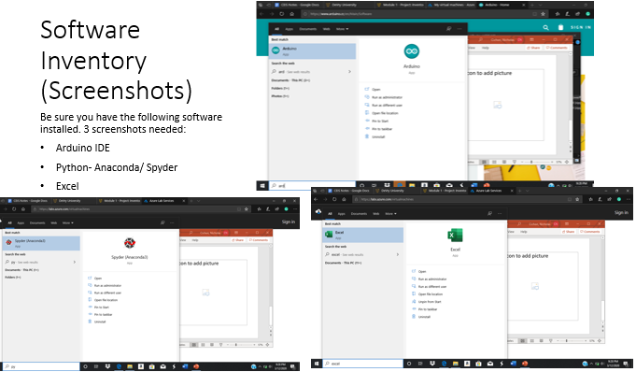

Slide 5
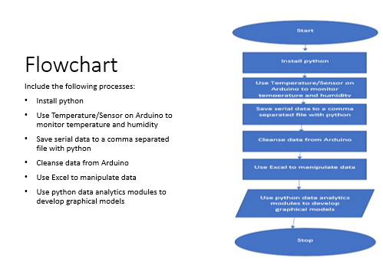

Slide 6
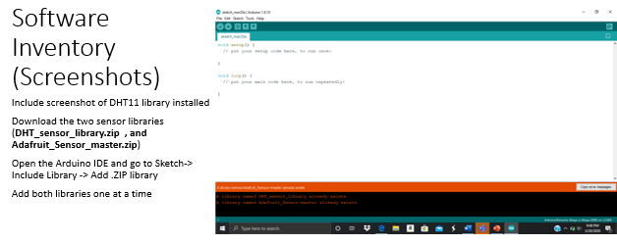

Slide 7
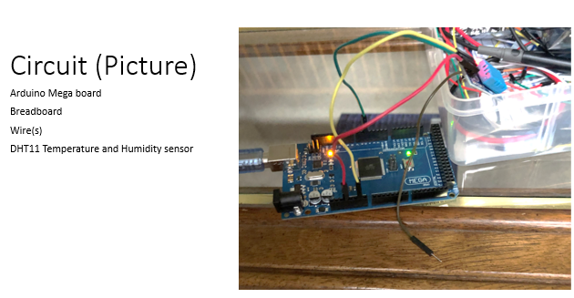

Slide 8
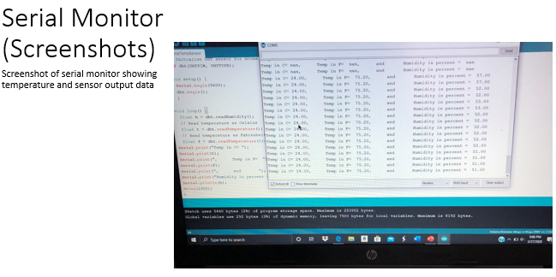

Slide 9
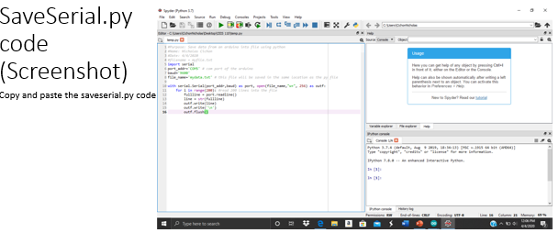

Slide 10
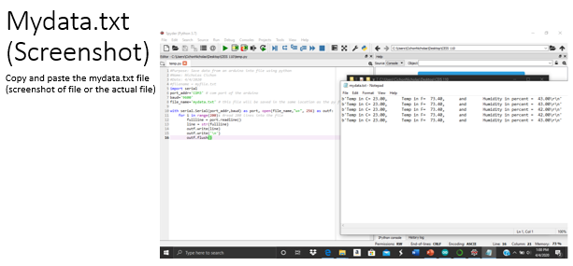

Slide 11
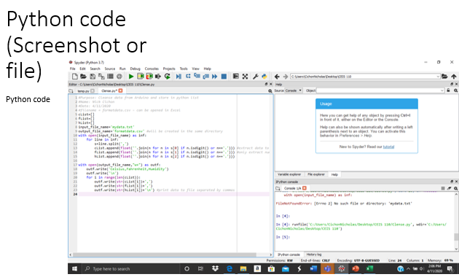

Slide 12
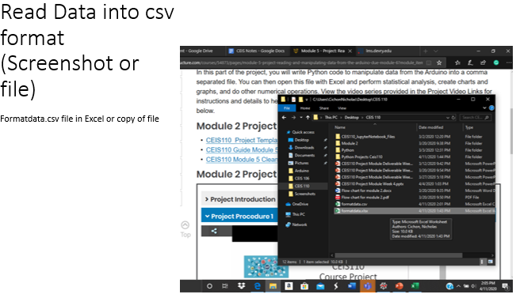

Slide 13
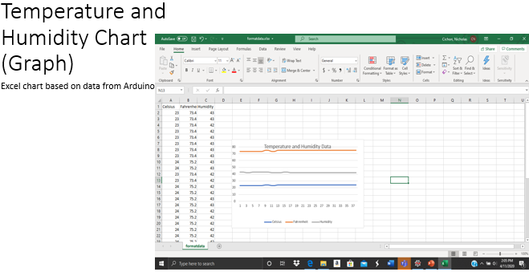

Slide 14
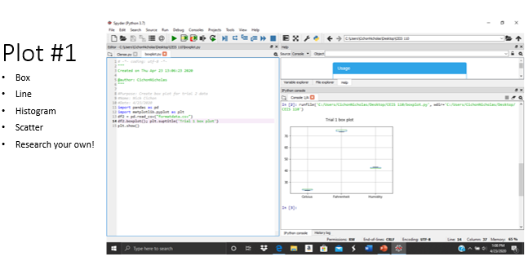

Slide 15
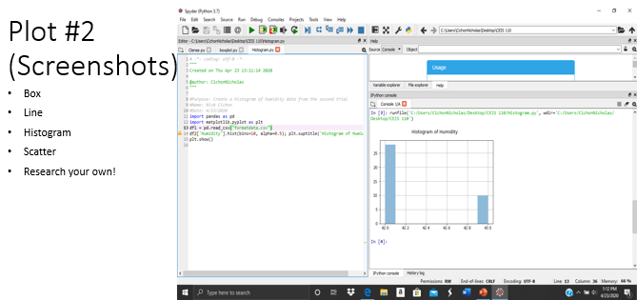

Slide 16
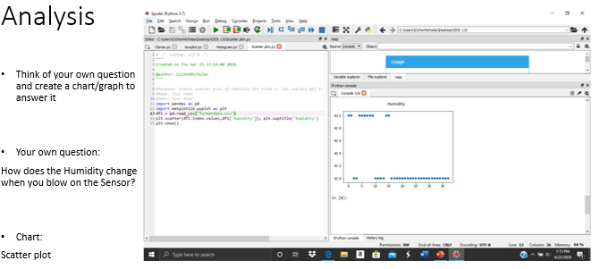

Slide 17
