Slide 1

PHYS 204: Final Project
BY: Nick Cichon

Slide 2


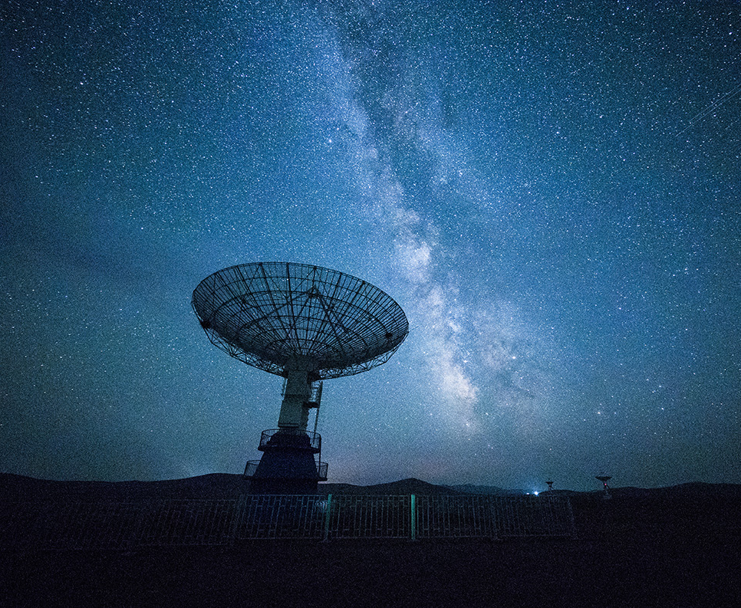
INTRODUCTION
For this class we conducted a variety of experiments using Arduino Tech Core Lab Kit. The purpose of the experiments was to understand how these Physic topics we learned in class can be correlated to our everyday life. I was surprised of how much we use physics in doing so. I also learned a great deal on how to organize your data using excel.

Slide 3
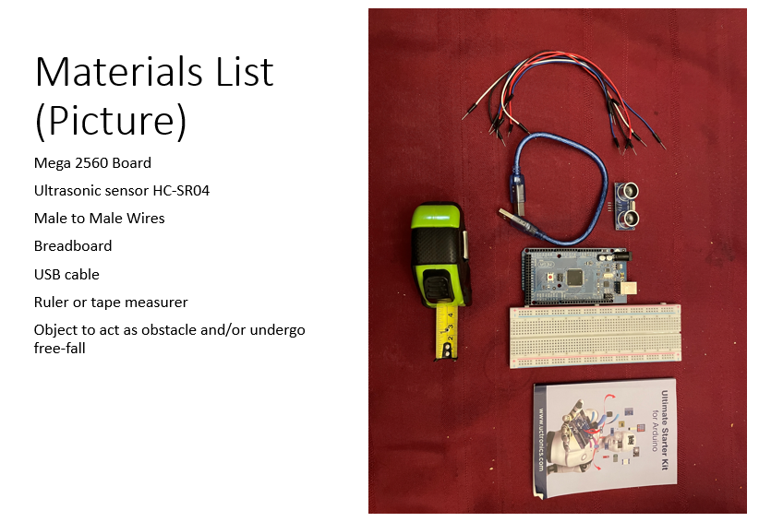
MODULE 1: Material List

Slide 4
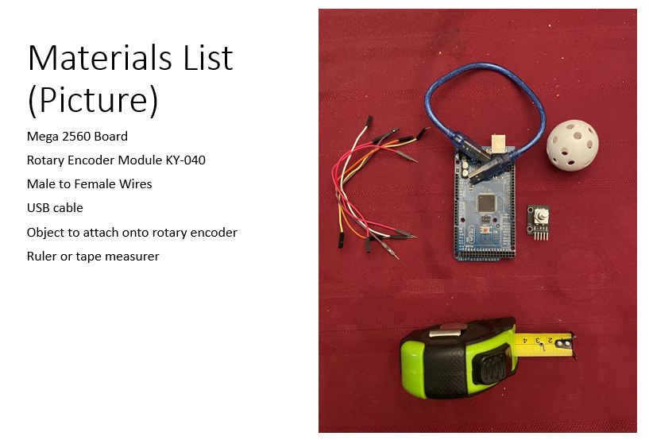
MODULE 1: Material List

Slide 5
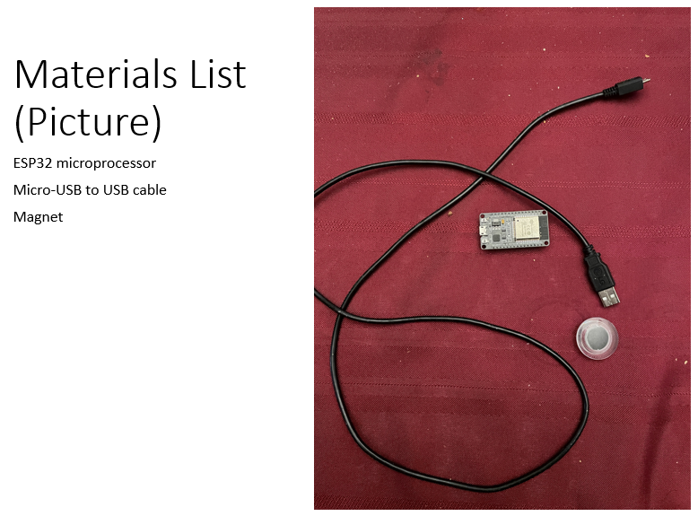
MODULE 1: Material List

Slide 6
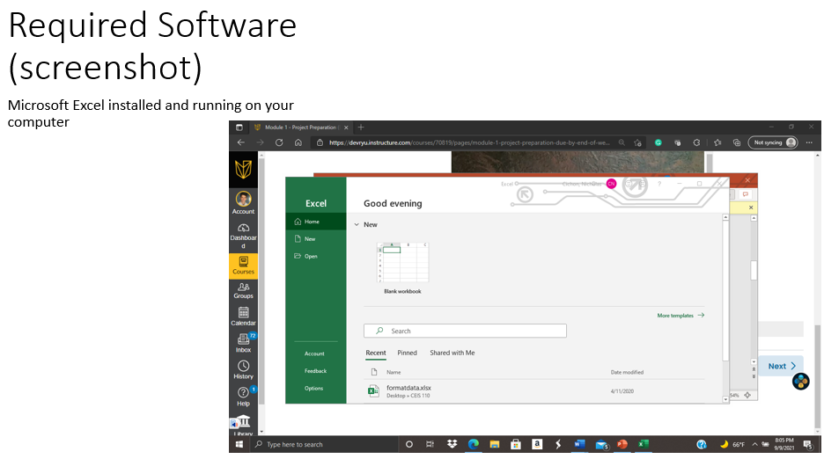
MODULE 1: Material List

Slide 7
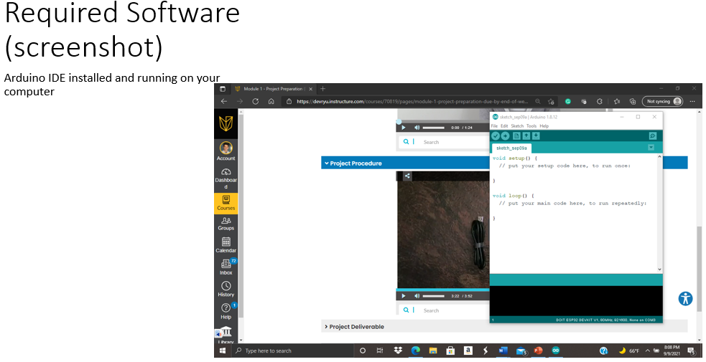
MODULE 1: Material List

Slide 8
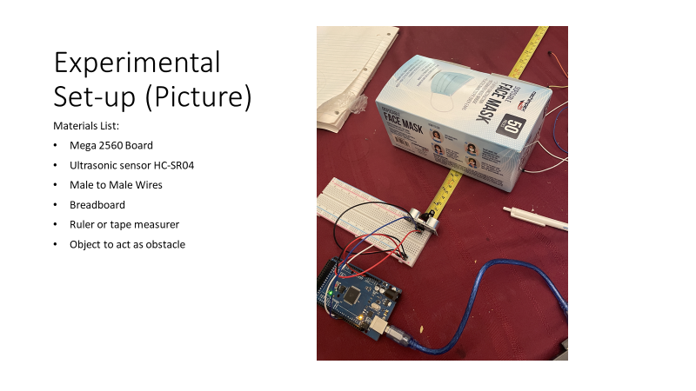
Module 2: Precision of the Ultrasonic Sensor

Slide 9
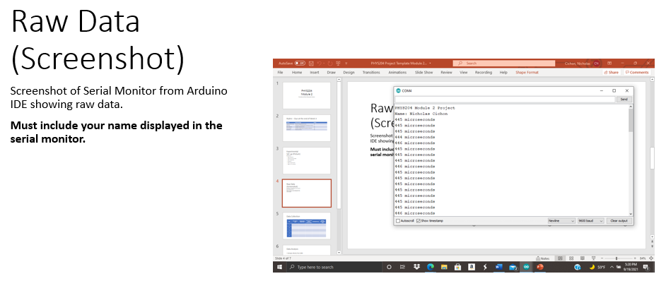
Module 2: Precision of the Ultrasonic Sensor

Slide 10
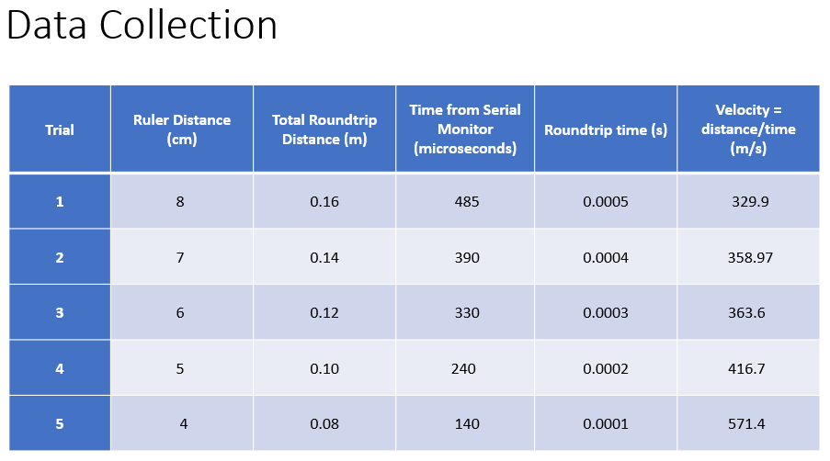
Module 2: Precision of the Ultrasonic Sensor

Slide 11
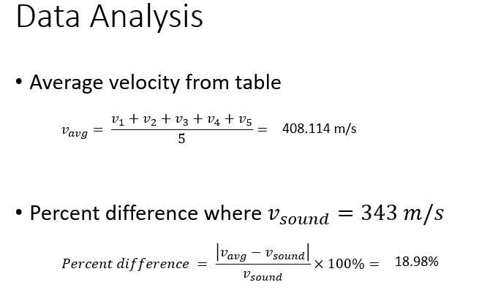
Module 2: Precision of the Ultrasonic Sensor

Slide 12
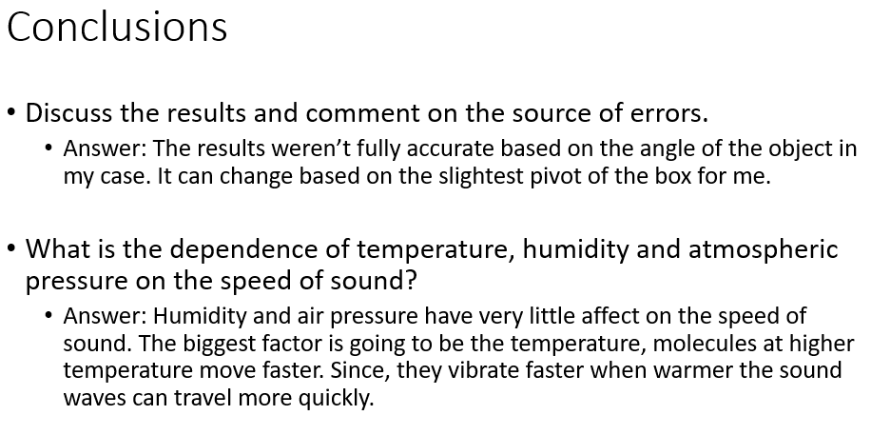
Module 2: Precision of the Ultrasonic Sensor

Slide 13
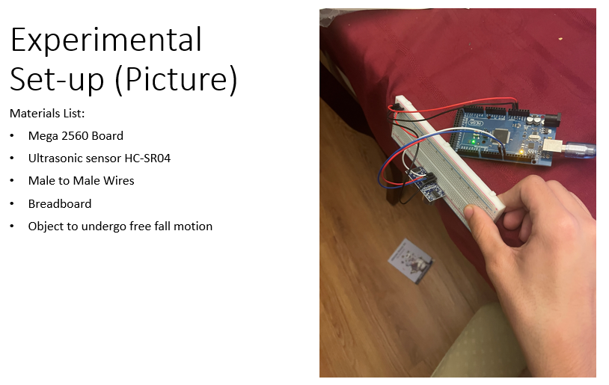
Module 3: Gravitational Acceleration

Slide 14
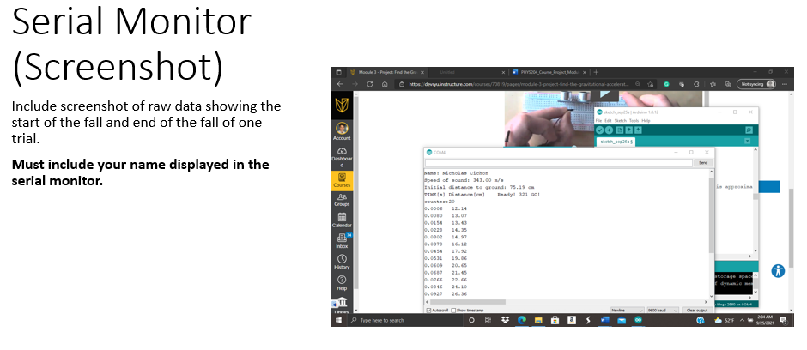
Module 3: Gravitational Acceleration

Slide 15
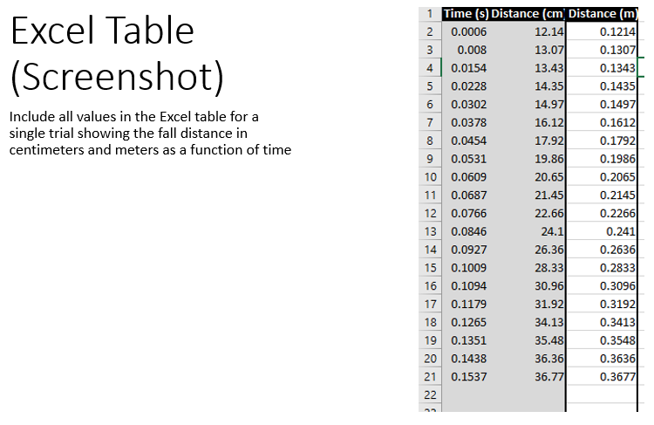
Module 3: Gravitational Acceleration

Slide 16
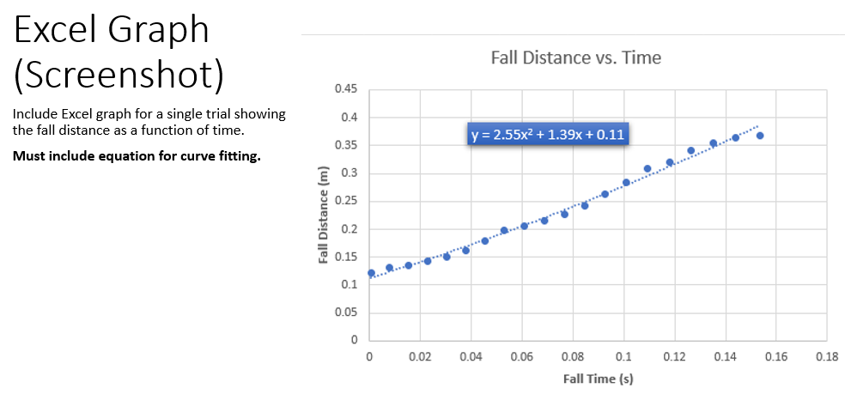
Module 3: Gravitational Acceleration

Slide 17
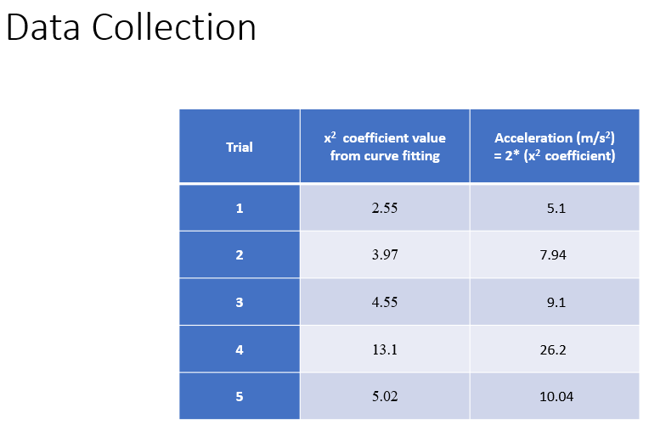
Module 3: Gravitational Acceleration

Slide 18
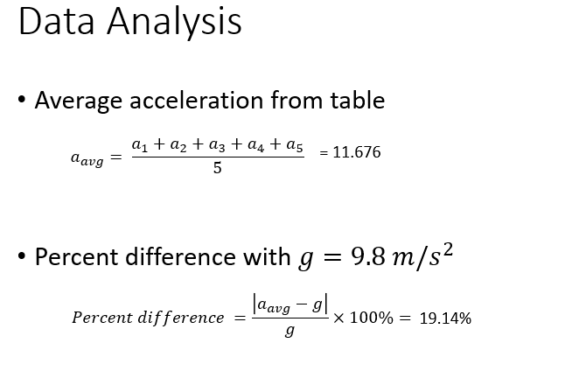
Module 3: Gravitational Acceleration

Slide 19
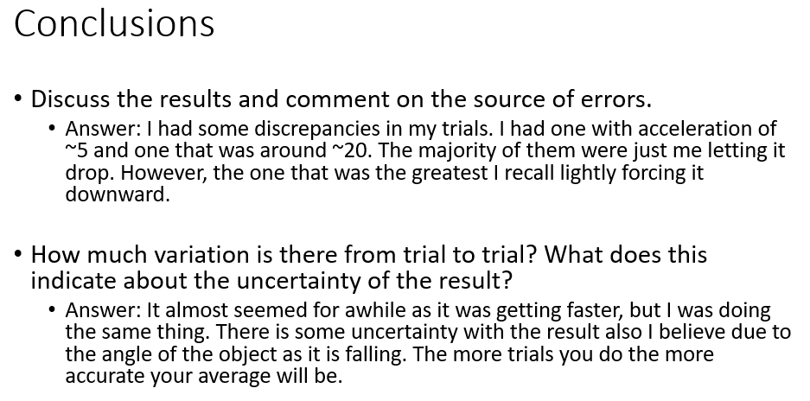
Module 3: Gravitational Acceleration

Slide 20
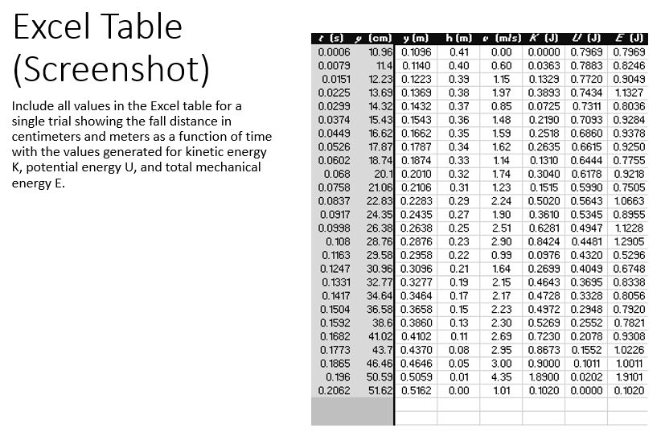
Module 4: Conservation of energy

Slide 21
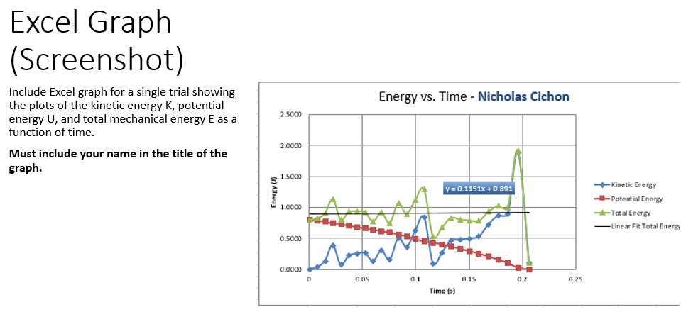
Module 4: Conservation of energy

Slide 22
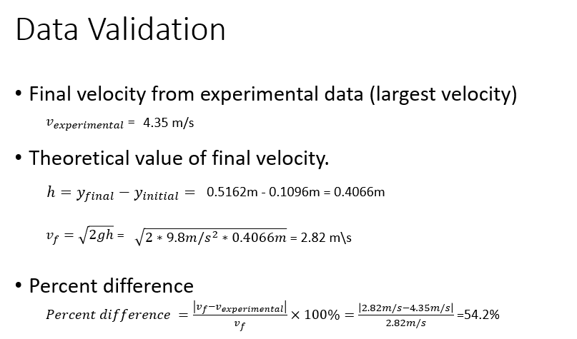
Module 4: Conservation of energy

Slide 23
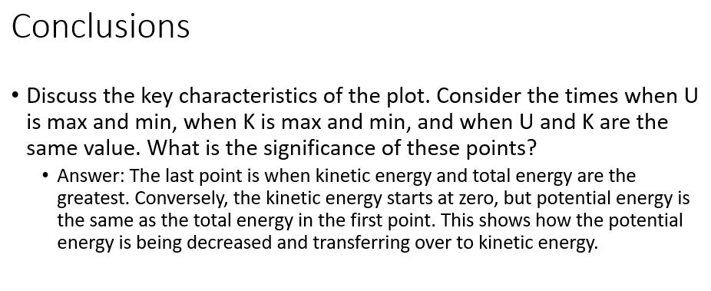
Module 4: Conservation of energy

Slide 24
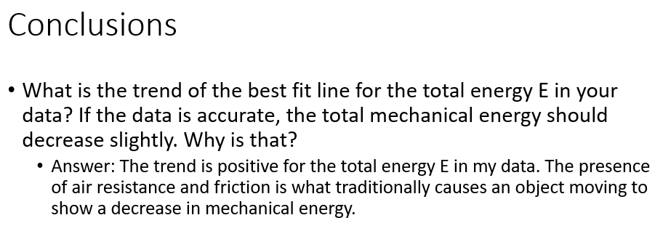
Module 4: Conservation of energy

Slide 25
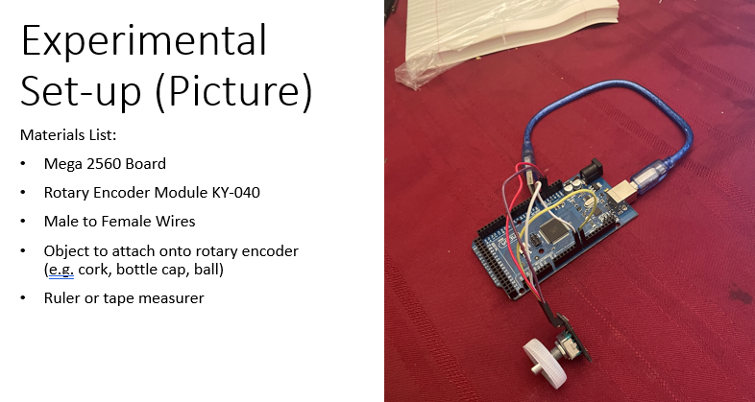
Module 5: rotational motion

Slide 26
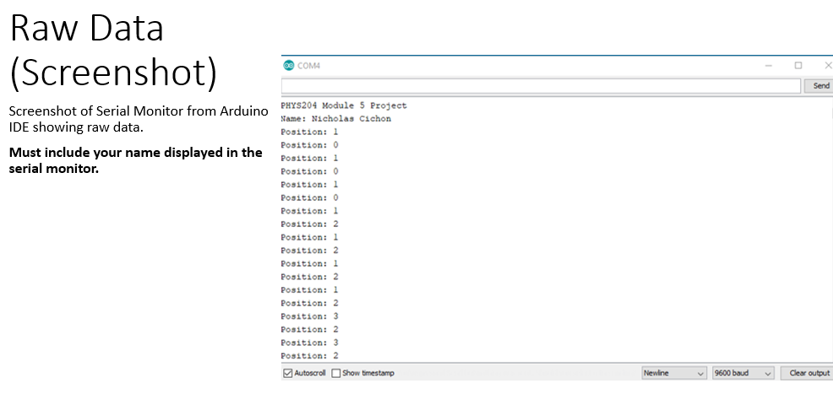
Module 5: rotational motion

Slide 27
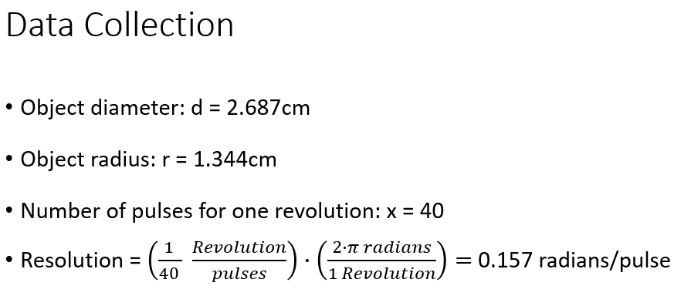
Module 5: rotational motion

Slide 28
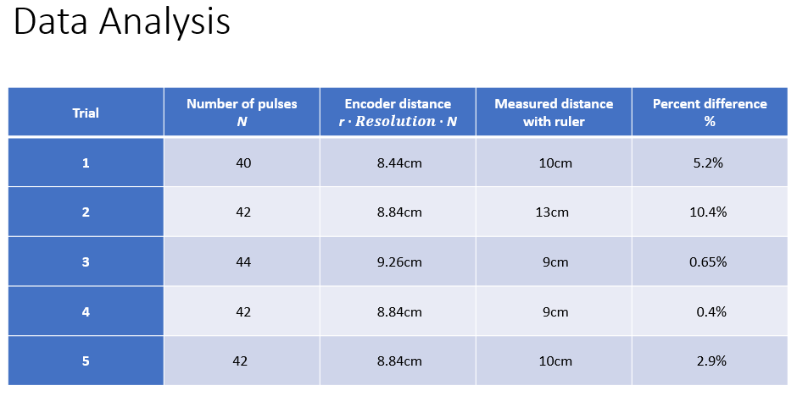
Module 5: rotational motion

Slide 29
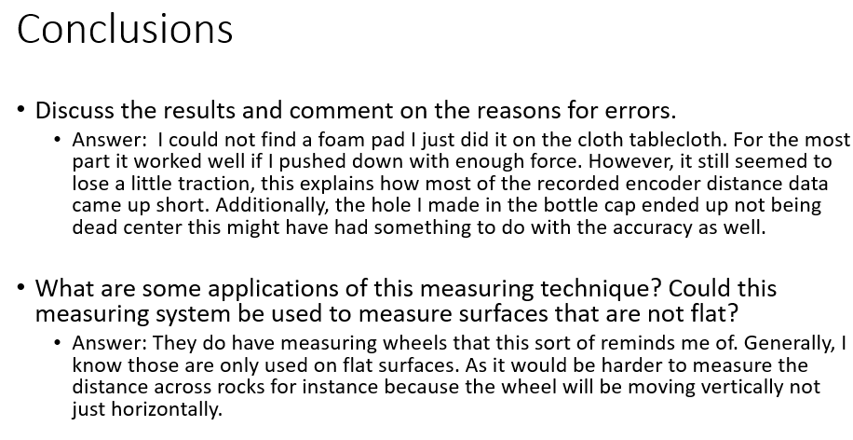
Module 5: rotational motion

Slide 30
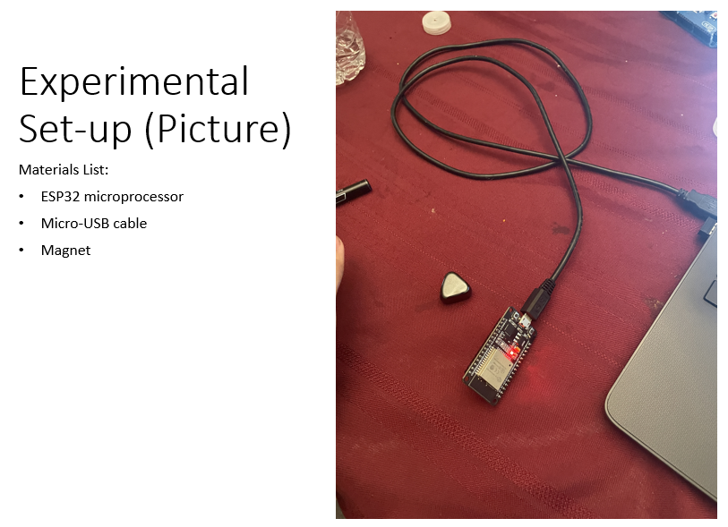
Module 6: Hall effect

Slide 31
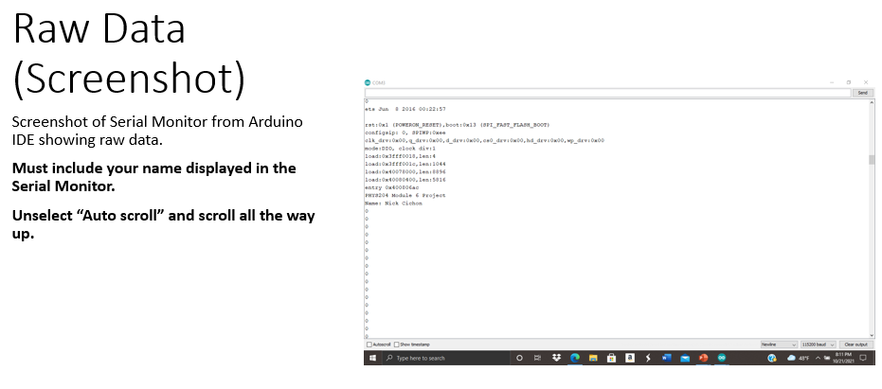
Module 6: Hall effect

Slide 32
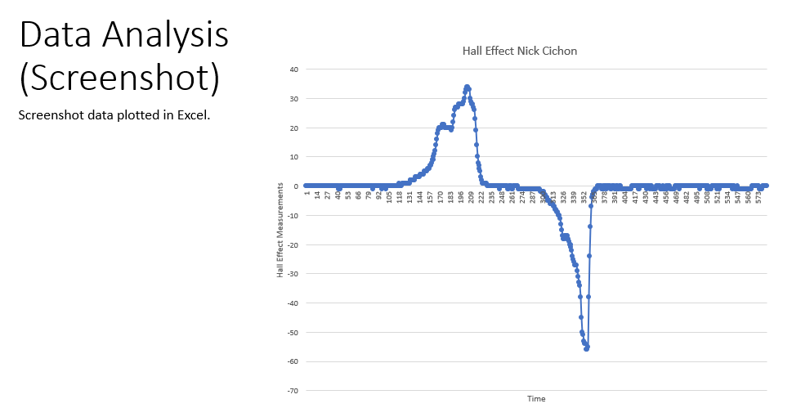
Module 6: Hall effect

Slide 33
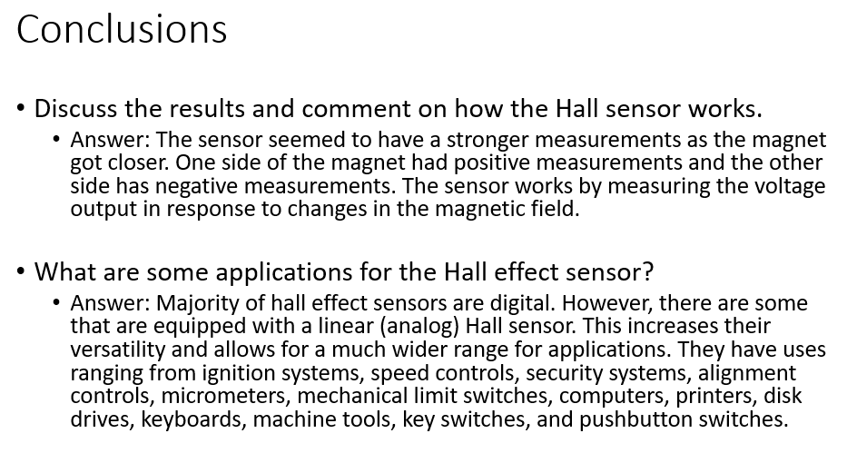
Module 6: Hall effect

Slide 34
Challenges
I did not encounter many notable challenges completing any of the experiments for this course. My only real challenge if you can even call it that was on the data collection. Because most of the sensors and devices we are using are scaled down versions of the actual devices used. The data sometimes seemed not completely accurate.

Slide 35

Thank You!

